Slide 1


Multilocus sequence typing (MLST) and cgMLST prediction from bacterial genomes
10 March 2026
Cebile Lekhuleni, NICD

Slide 2
Multi-locus Sequence Typing (MLST)
MLST is a method that assigns bacterial isolates to sequence types (STs) based on the allelic profile of typically seven housekeeping genes
e.g. rpoB, gapA, mdh, pgi, phoE, infB, tonB for Klebsiella
Key features of MLST:
Uses internal fragments of conserved “housekeeping” genes.
Each unique allele at each locus is assigned a number.
The combination of allele numbers across all loci defines the ST (e.g. ST78 for Klebsiella pneumoniae).
Databases hosted via BIGSdb at pubmlst.org, incorporated into many tools
Highly portable, reproducible, standardized — data comparable across labs and databases.

Slide 3
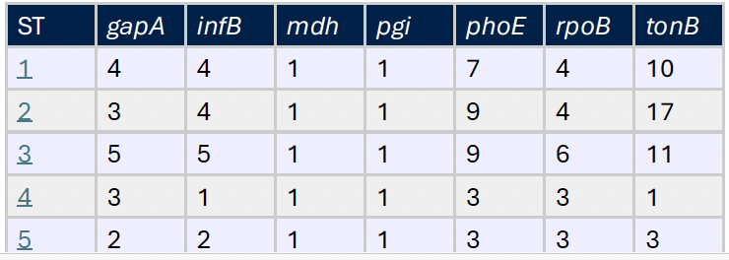
Multi-locus Sequence Typing (MLST)
MLST database made up of:
i. set of all allele sequences
ii. lookup table of allele number combinations to ST
Klebsiella MLST scheme
- Currently has >7500 unique allelic profiles
Slide courtesy: Assistant Professor Zoe A. Dyson

Slide 4
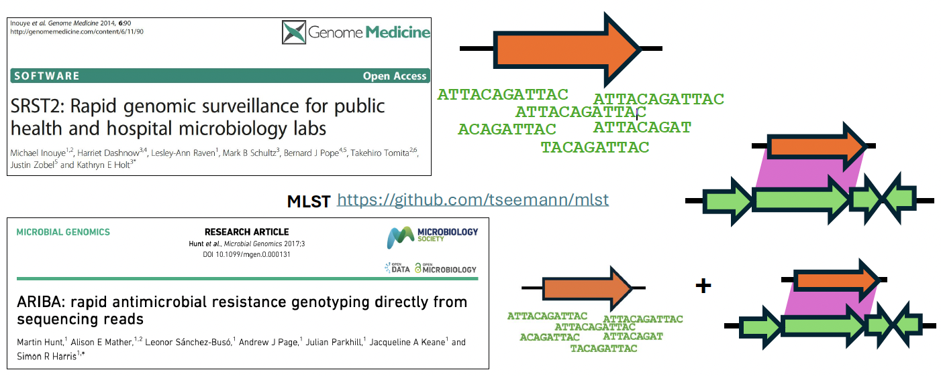
Multi-locus Sequence Typing (MLST)
Several general software tools have been developed that can use MLST schemes to type isolates from WGS data
These software tools can be used to analyse WGS data for any pathogen where an MLST scheme has been developed
Slide courtesy: Assistant Professor Zoe A. Dyson
Notes:
SRST2 (Short Read Sequence Typing for Bacterial Pathogens) is a command-line tool designed to identify Multilocus Sequence Types (MLST) and resistance/virulence genes directly from raw Illumina sequencing reads. It uses read mapping to align reads against a database of known alleles, making it faster and more accurate than assembly-based methods for, e.g., S. pneumoniae

Slide 5
Strengths & Limitations of MLST
Strengths:
Standardized, portable typing.
Good for population structure, global epidemiology, lineage assignment.
Limitations:
Only a small fraction of the genome (~7 loci) is interrogated → limited resolution.
Not ideal for distinguishing very closely related isolates (e.g. in outbreak investigations).

Slide 6
Gene-by-Gene approaches
With whole-genome sequencing (WGS), we no longer need to limit to a few housekeeping genes.
Gene-by-gene (GbG) typing compares genomes using a predefined schema of loci (genes) and assigns alleles per locus, analogous to MLST but on a larger scale.
Schemas can be:
Core genome (genes present in nearly all isolates) → cgMLST
Pan-genome / whole genome → wgMLST or cgMLST/accessory-genome MLST

Slide 7
Gene-by-Gene approaches - cgMLST
Core-genome MLST (cgMLST) expands the MLST concept to hundreds to thousands of loci shared across most or all genomes of a species
Benefits:
Much greater resolution – reveals fine-scale relationships between isolates.
Still standardized and portable (allele-based) across labs
Useful for outbreak detection, transmission mapping, and detailed epidemiology

Slide 8
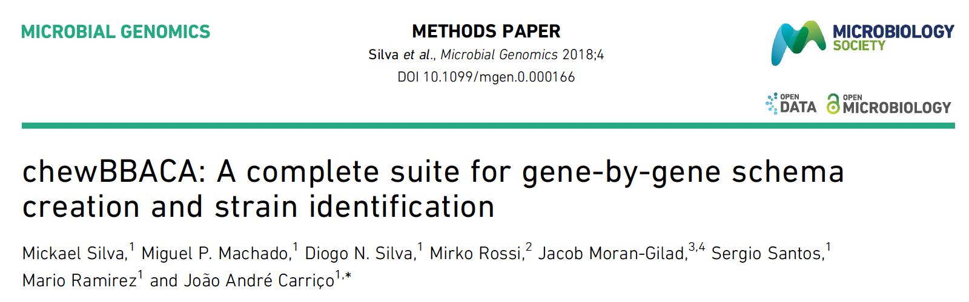
cgMLST using chewBBACA
chewBBACA provides schema creation and allele calling for genome-by-genome typing
Works on draft or complete genomes (assemblies) — suitable for labs without reference-based mapping
Enables reproducible, scalable cgMLST workflows even on modest computing resources

Slide 9
When to Use MLST vs cgMLST
Scenario | Preferred method
Global population structure, long-term epidemiology, community-level surveillance | MLST
High-resolution outbreak investigation, transmission mapping, hospital surveillance | cgMLST
Resource-limited settings with limited genome data | MLST or small-scheme cgMLST
Comparative genomics across diverse strains / broad sampling | cgMLST (or wgMLST)

Slide 10
MLST visualisation using PHYLOViZ
S. pneumoniae serotype 19A MLST genotypes
Grouped by lineage
Coloured by resistance profile
PHYLOViZ visualisation
Unpublished work

Slide 11
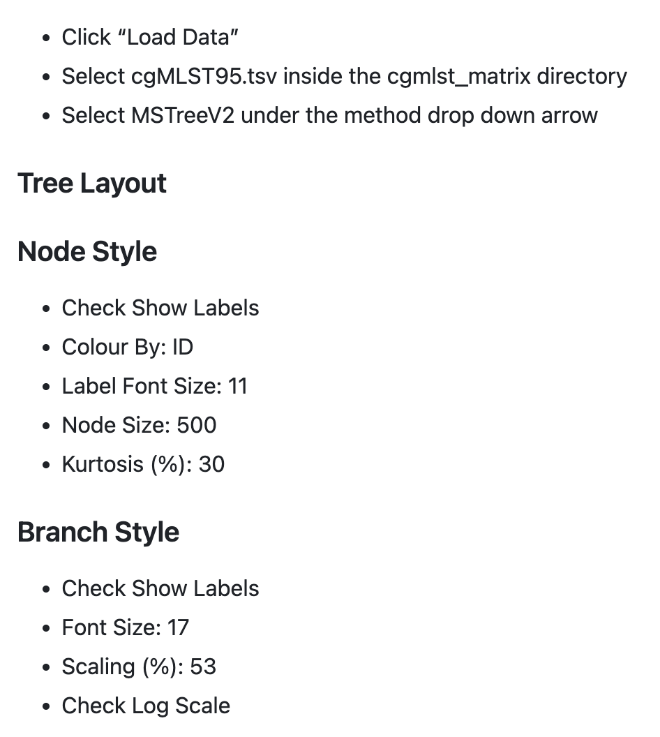
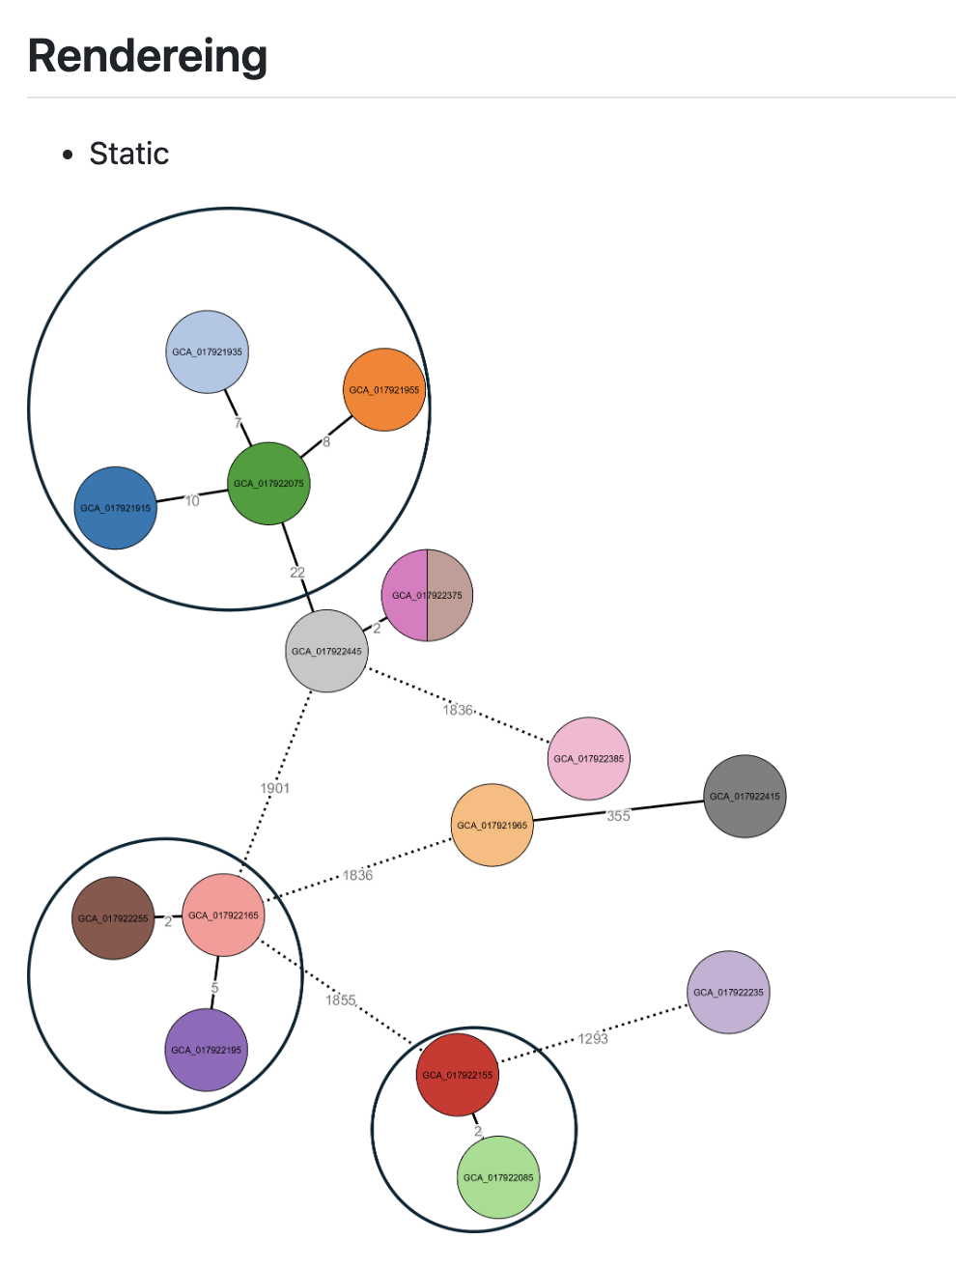
cgMLST visualisation using GrapeTree

